Slide 1

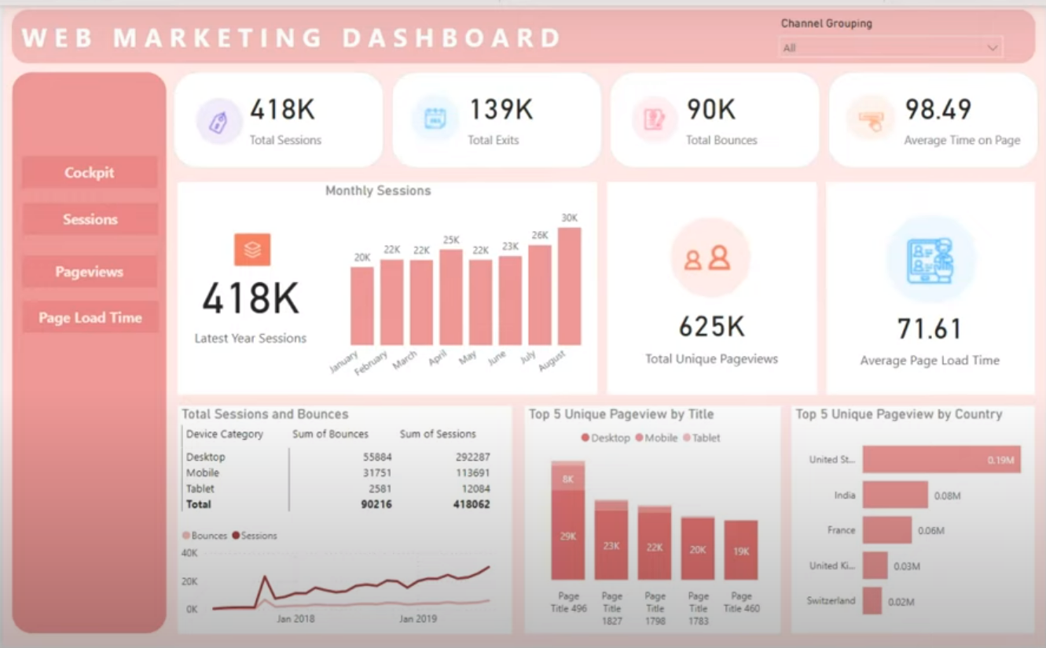

Slide 2
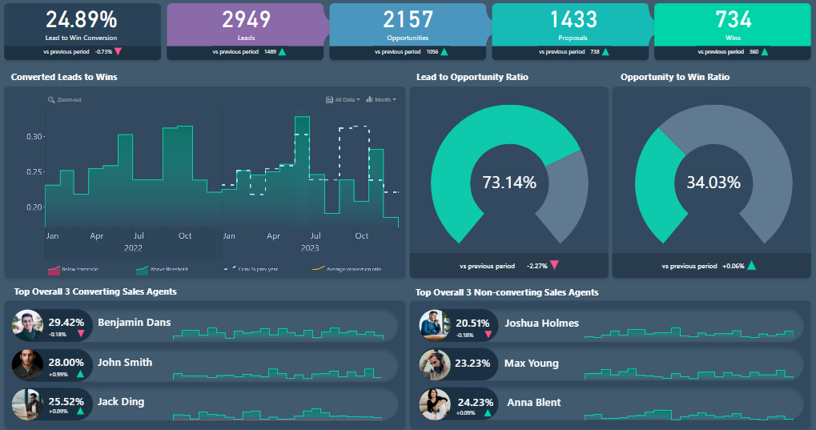
Lead Generation Dashboard
Lead Generation Dashboard.

Slide 3
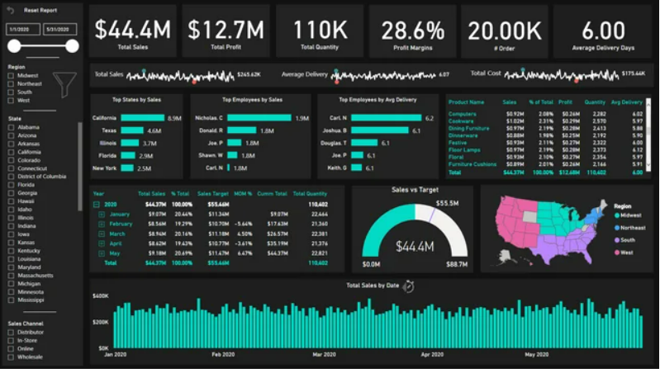
Sales Dashboard

Slide 4
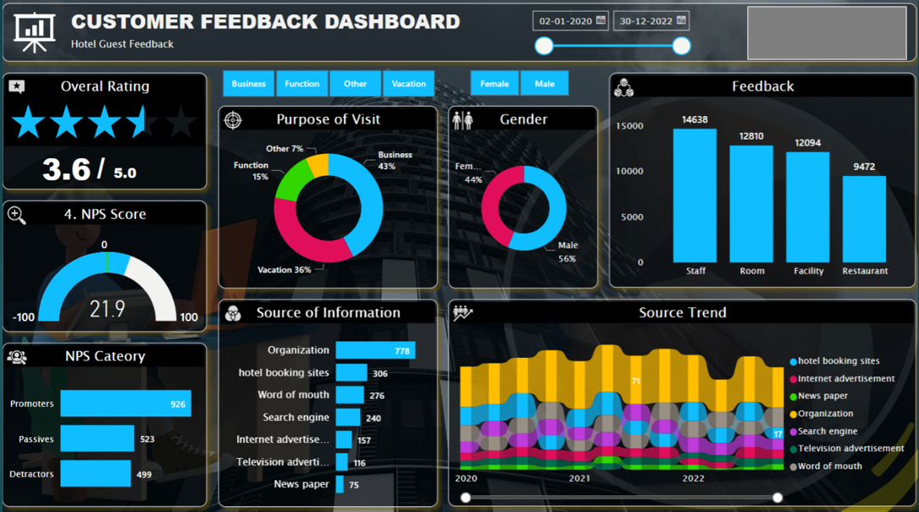

Slide 5
